Slide 1
The Doncaster Innovation Challenge: Design, Process and Implementation
Danielle Timms and Zoe Catterall
Doncaster - Sheffield City Region

Slide 2
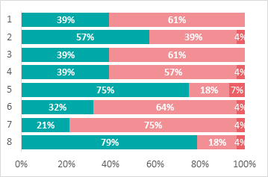
The Design
Summer 2019 data and Careers Leader feedback through the Careers Hub indicated that Gatsby Benchmark 4 was a priority area.
Doncaster needed a solution/scheme/idea to engage schools with concept of linking careers to the curriculum.
An effective and new way to do this was through a borough-wide, interschool challenge.

Slide 3
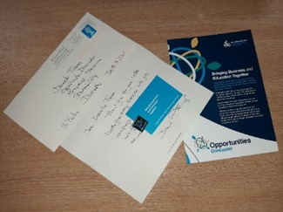
The Design
It was deemed an essential requirement that the challenge was topical, relevant and purposeful in order to gain school staff and student buy-in.
A way to address this was to identify current issues in the media: At that time, Sir David Attenborough had made a surprise appearance at Glastonbury festival to thank the crowd for helping to reduce the use of plastic at the event.
It was decided that the theme should be single-use plastic and sustainability.
The letter received from Sir David Attenborough wishing luck for the challenge.
The Process
Local and national businesses with a link to single-use plastic and sustainability in the Doncaster Enterprise Adviser and Cornerstone network were contacted and three businesses chose to be involved.
Two businesses wished to pose a scenario and one wished to introduce the overall challenge and create a video which informed viewers about the current issues which link to single-use plastic and sustainability.
The two businesses were supported in writing scenarios which were real and relevant to their businesses, in-keeping with current themes in the media and accessible to KS3 students. The third business was also supported with the relevant material they needed to make their video bespoke to the Doncaster Innovation Challenge.

Slide 4
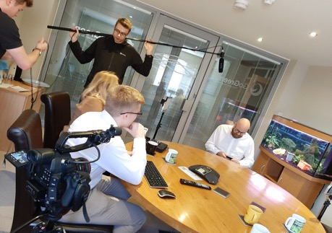
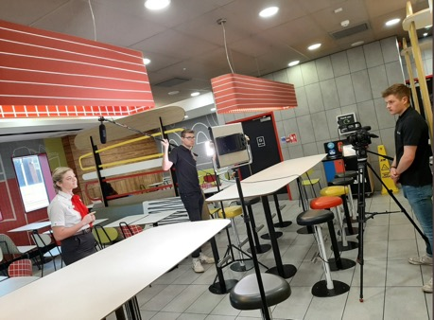
The Process
To maximise the amount of schools who were able to engage with the challenge, the two businesses and a local media company were supported in writing their own scripts and filming themselves in their workplace, explaining their business’ scenario and what students needed to do to help them solve it.
Scenario by Business 1 asked students to use the business’ Waste Hierarchy System to create a poster, social media campaign or educational demonstration in school, which raised the profile of using and recycling single-use plastic.
Scenario by Business 2 asked students to design a sustainable alterative to a child-friendly product which is currently created from single-use plastic, meaning the product cannot be recycled.
Follow the below link to see one of the business scenarios:
https://vimeo.com/369876620/e39ffa2931

Slide 5
The Process
Alongside each video, a teaching pack was developed which included:
Lesson plans
Ideas and ways for students to engage with the videos
Wider Curriculum links
Delivery method options
A suggested teaching model
Skeleton resources which schools could personalise, select the relevant content from or just use as a basic tool to deliver the challenge.

Slide 6
The Implementation
The challenge was shared at a Hub Huddle (where Careers Leaders are brought together as a best practice sharing network).
Schools signed up for the resources through a Survey Monkey and received the resources electronically.
School staff delivered the challenge themselves using the teaching pack and provided resources. Some schools chose to take part in one challenge, others did both. Schools taught the challenge as part of their lesson content, a Drop-Down Day or as Eco-club content.
As part of delivery, schools were asked to democratically vote on a winner. Some involved their Enterprise Adviser, Senior Leadership Team (SLT) and other pupils in this process.
The winning team from each school attended a final at Opportunities Doncaster Live, the borough’s largest Careers event which is held in Doncaster Careers Week.

Slide 7
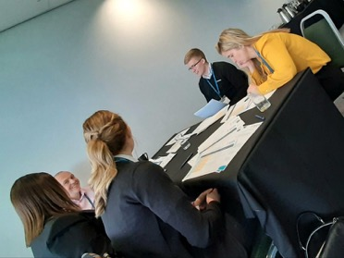
The Implementation
At the final, the winning teams from each school pitched their ideas and designs to a panel generated of representatives from the businesses in a Dragon’s Den style.
The pupils were presented with finalist certificates and had their pictures taken with the business representatives.
Once all the teams had presented, the judges deliberated and decided on a winner for each scenario.
The winners for each scenario were informed via email to their lead staff member.
A celebration assembly was arranged for each winning team where their achievement was acknowledged with a school trophy.

Slide 8
Feedback
What the businesses said…
“The day was both a great showcase for the pupils and schools of Doncaster and inspirational/ valuable to support as a business. As I said on the day I recommend the opportunity get involved to any business and anyone within a business that is involved.”
“I was so impressed with the quality of the ideas and presentations from your schools that I even mentioned them when we met with the Department for Education on Thursday to discuss how they should support all schools in England to become Eco-Schools. They were equally impressed when I told them about some of the ideas your students had pitched and from across such a broad range of curriculum areas.”
“It was a pleasure to help out with the judging, I was genuinely blown away by what some of the students produced. It made my day to see the students show so much passion towards the task we had set.”

Slide 9
Feedback
What the schools said…
“It was a great opportunity for our students and one we would hope to participate in again in the future.”
“Thanks again for giving our students this opportunity, the girls all loved it and it will certainly have developed their character.”
“Thanks for all the hard work you put into the Challenge, our students loved taking part in the semi-finals in the Academy and it was a real privilege for them to be able to present yesterday in such a lovely venue and with such distinguished judges”

Slide 10
Top Tips for using a similar model:
Pick a topical, relevant subject that is real and has a purpose – you may have to reinvent the wheel to achieve this!
Provide the tools, resources and support for school staff to deliver and overcome any barriers.
Monitor and ‘check-in’ by discussing in general conversation when schools were discussing Gatsby Benchmark 4.
Encourage the Careers Leader to link with Subject Leads/Specialist staff – the majority of Careers Leaders supported another member of staff in delivering the challenge.
Don’t hesitate to ask your employer links who wish to develop their school engagement to get involved!

